Slide 1


Implementation and evolution of a community health worker-led COVID-19 contact tracing intervention in Chiapas, Mexico
November 4, 2022
Zeus Aranda Remon
Research & Impact Coordinator, Partners In Health Mexico (Compañeros En Salud)

Slide 2
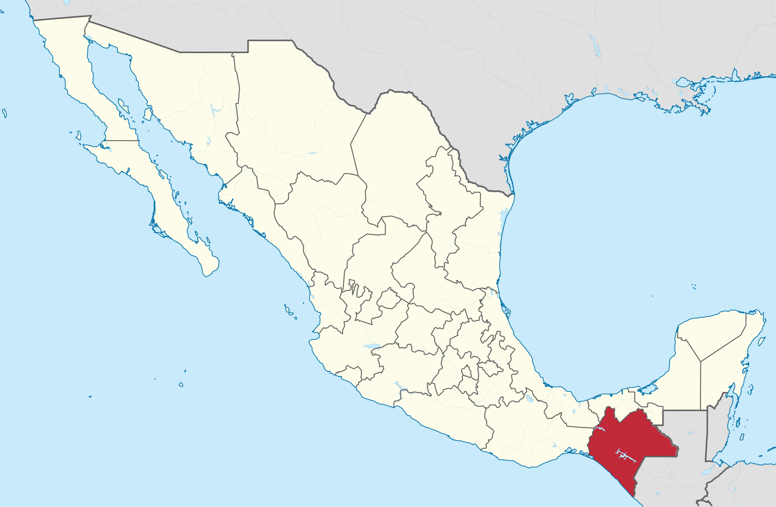
Wikimedia Commons
Authors
Zeus Aranda^{1,2}, Sandra Vázquez¹, Anuraag Gopaluni³, Laura Martínez⁴, Mayra Ramírez¹, Ariwame Jiménez¹, Daniel Bernal⁵, Ana L. Rodríguez^{1,6}, Selene Chacón⁶, Bruno Vargas¹, Isabel R. Fulcher^{7,8}, Dale A. Barnhart^{7,9}, Cross-site COVID-19 Syndromic Surveillance Working Group
¹Partners In Health Mexico (Compañeros En Salud), Ángel Albino Corzo, Chiapas, México. ²Departamento de Salud, El Colegio de la Frontera Sur, San Cristóbal de las Casas, Chiapas, México. ³Department of Biostatistics, Harvard T.H. Chan School of Public Health, Boston, MA, USA. ⁴Partners In Health Peru (Socios En Salud), Lima, Perú. ⁵Escuela de Gobierno y Transformación Pública, Instituto Tecnológico de Monterrey, Ciudad de México, México. ⁶Instituto Nacional de Salud Pública/Escuela de Salud Pública de México, Cuernavaca, Morelos, México. ⁷Department of Global Health and Social Medicine, Harvard Medical School, Boston, MA, USA. ⁸Harvard Data Science Initiative, Boston, MA, USA. ⁹Partners In Health Rwanda (Inshuti Mu Buzima), Kigali, Rwanda.

Slide 3
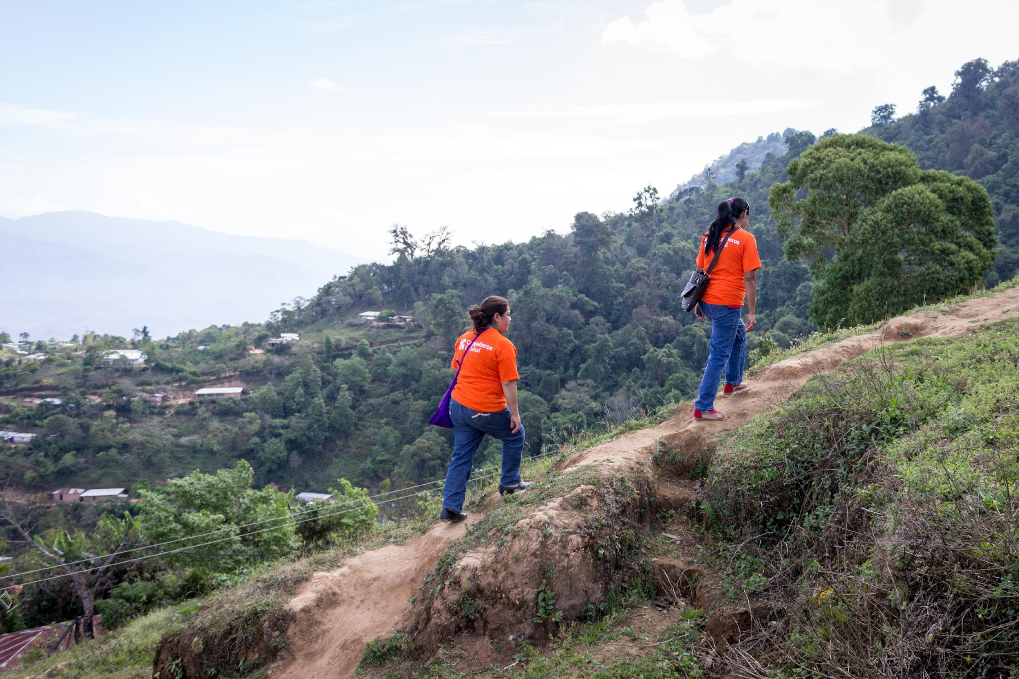
Background
Between February 2020 and mid-August 2022, Mexico reported nearly 7.2 million confirmed COVID-19 cases and over 342,000 deaths.
Mexico was the country with the second highest rate of excess mortality due to the COVID-19 pandemic for the period January 2020 to December 2021, with 325 estimated deaths per 100,000 inhabitants.
People living in already marginalized areas is more likely to present with severe symptoms of COVID-19 disease.
Chiapas, the poorest state in Mexico, has suffered disproportionately from the ongoing health emergency; it has experienced an exacerbation of pre-existing shortages of health professionals, medical supplies, and beds.
In this context, SARS-CoV-2 infection prevention and control interventions that can reduce the number of cases, especially among high-risk patients who are more likely to require hospitalization, are critically important.
CONACYT - CentroGeo - GeoInt - DataLab. COVID-19 Tablero México. 2022.
Ortiz-Hernández L, Pérez-Sastré MA. Inequidades sociales en la progresión de la COVID-19 en población mexicana. Rev Panam Salud Pública. 2020.

Slide 4
Background
In March 2020, Compañeros En Salud implemented a community health worker (CHW)-led contact tracing intervention in eight rural communities of the Fraylesca and Sierra Mariscal regions.
For all patients in eight outpatient clinics who met the Mexican MoH definition for a suspected COVID-19 case and their contacts who accepted the intervention.
All data were recorded in a CommCare-based mobile app.
Mar 2020
Sep 2020
Oct 2020
Mar 2021
1st COVID case in Chiapas
45 CHWs assigned to support contact tracing
CHWs receive PPE and training on contact tracing
Paper-based data collection entered in a CommCare app by CHW supervisor
CHWs begin entering data directly into the App
10 dedicated CHWs assigned to support contact tracing and receive additional incentives
New version of the contact tracing app ease digital data collection by CHWs
New algorithm for contact follow-up
New version of contract tracing app launched to accommodate new follow-up schedule for contacts

Slide 5
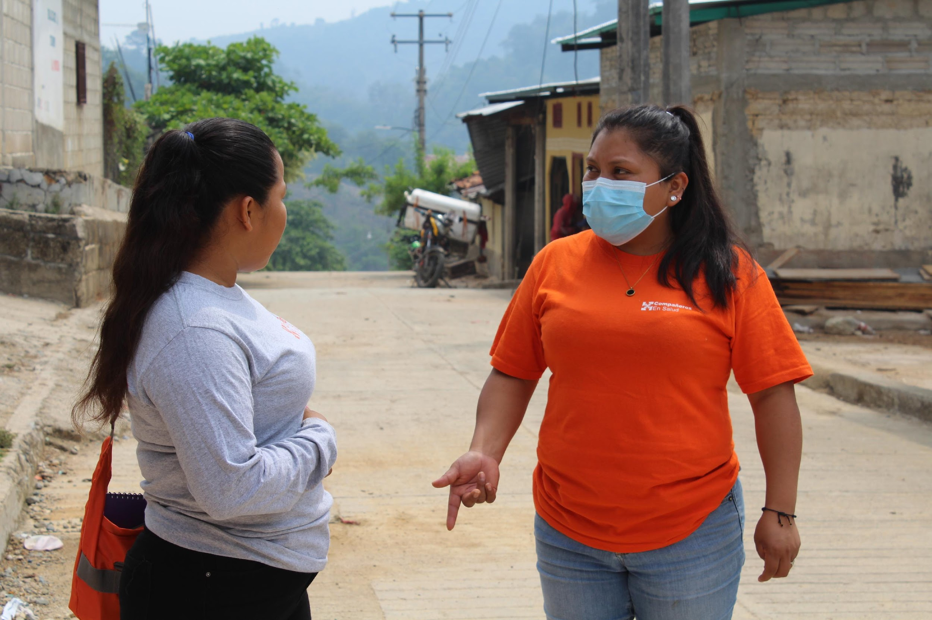
Methodology
In this study we documented the implementation and evolution of the intervention and assessed a)the evolution of two process indicators (contact tracing coverage and successful completion of contact tracing) and one outcome indicator (incidence of suspected COVID-19 among contacts) using descriptive statistics and b)their association with demographic characteristics of contacts and the intervention period using inferential statistics (univariate and multivariate logistic regression).

Slide 6
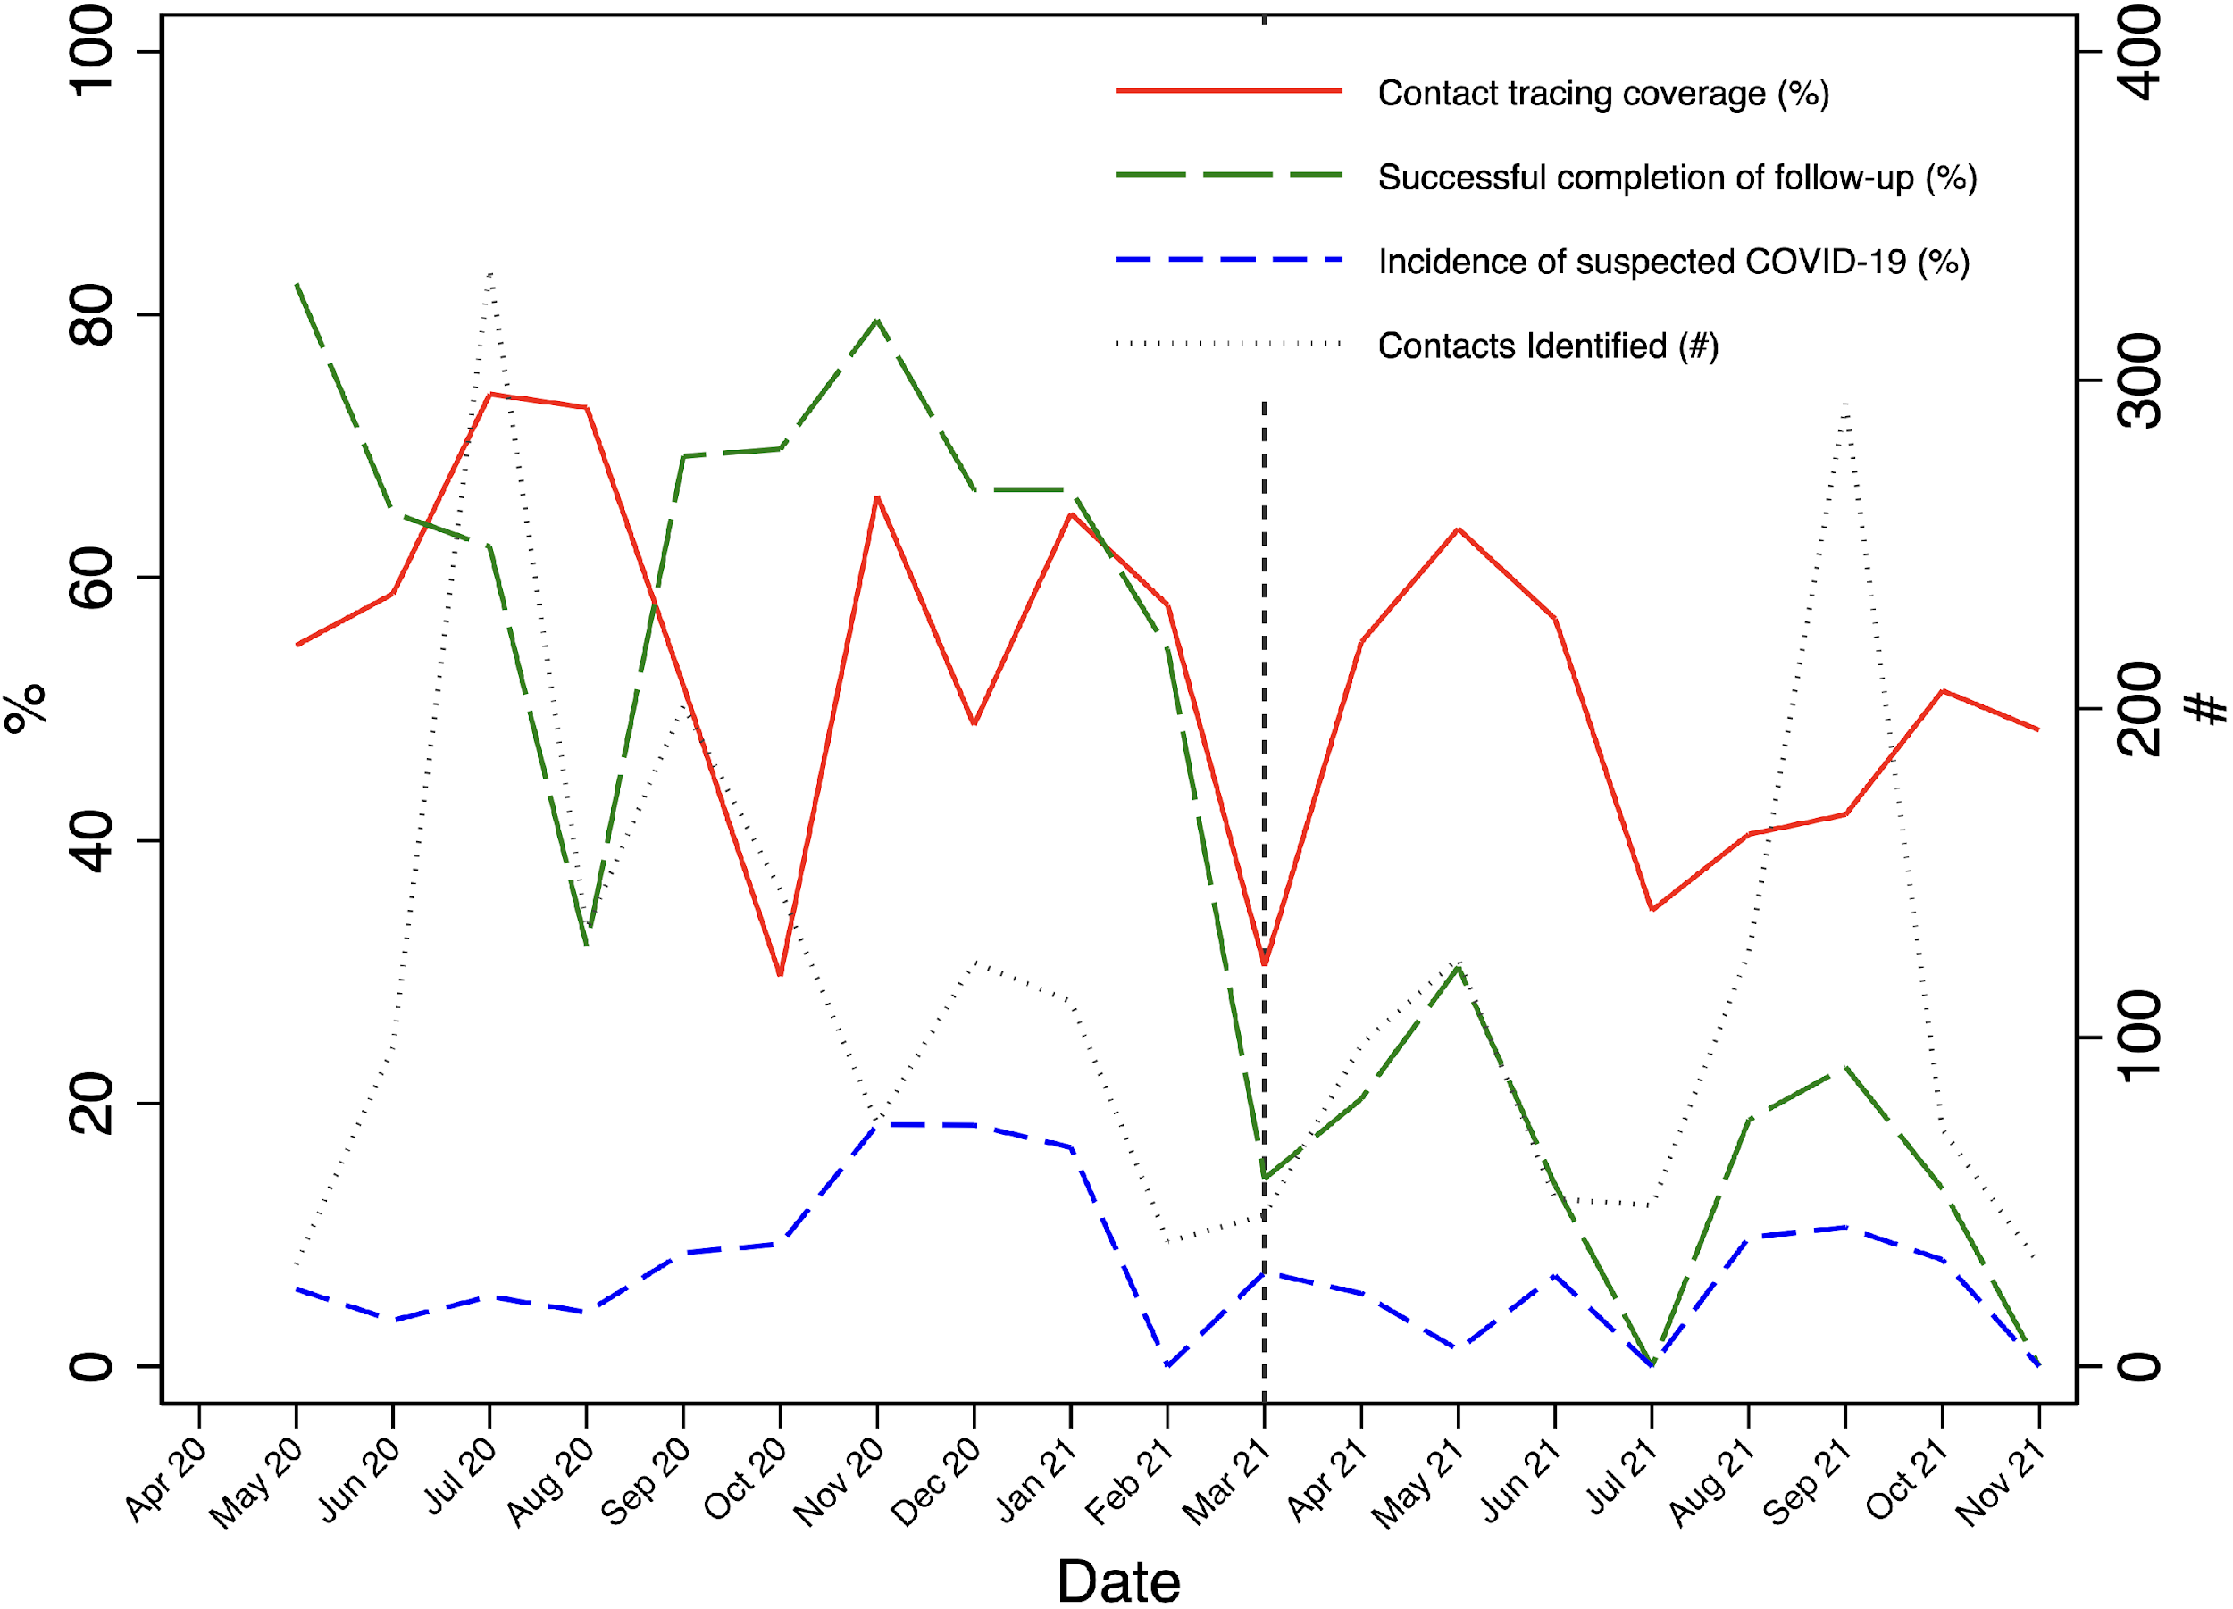
Results
From a roster of 2,177 named contacts, 1,187 (54.5%) received at least one home visit by a CHW and 560 (25.7%) had successful completion of contact tracing according to intervention guidelines.
Of 560 contacts with complete contact tracing, 93 (16.6%) became suspected COVID-19 cases.
We observed significant associations between sex and coverage (p = 0.006), sex and complete contact tracing (p = 0.049), community of residence and complete contact tracing (p = 0.005), and intervention period and both coverage and complete contact tracing (p < 0.001).
Evolution of the Compañeros En Salud-contact tracing intervention outcomes from April 2020 to November 2021.

Slide 7
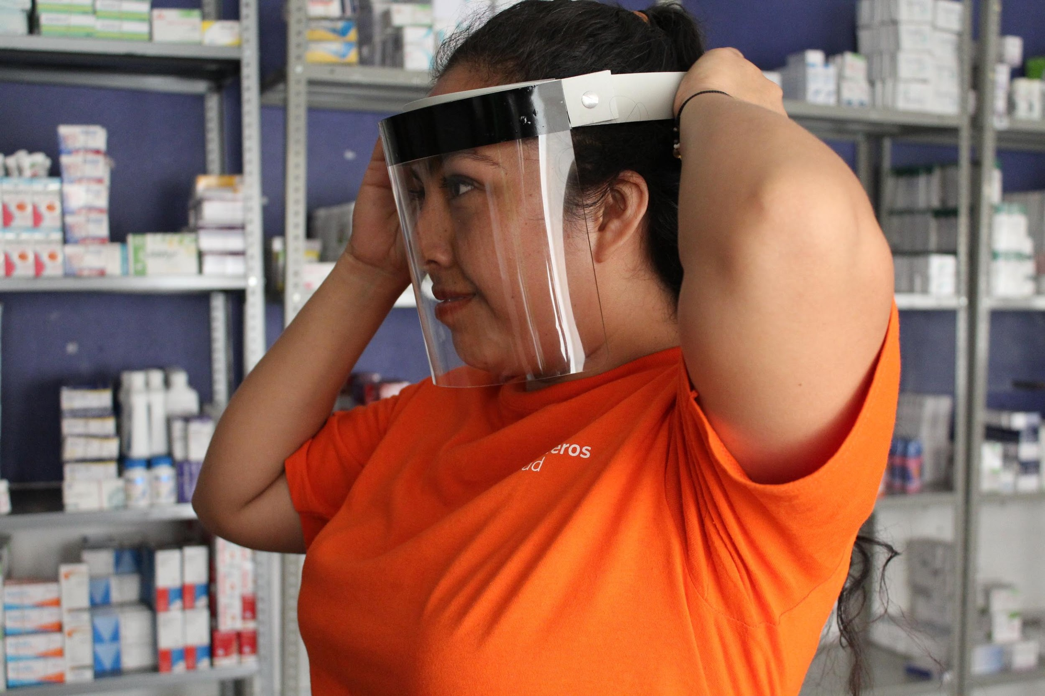
Discussion
Although we observed statistically significant differences between genders, contact tracing coverage and successful completion were less than 60% for both genders, pointing to a need for general programmatic strengthening.
Coverage was lower than in other contact tracing interventions involving CHWs worldwide (71-100%).
Successful completion was also lower than in other interventions (89-100%).
Incidence of suspected COVID-19 among contacts was similar to other contact tracing interventions (in Uganda, Nigeria, and the US), but much higher than in Rwanda (2%) and lower than in Oman (45%).
Implementation barriers:
Extremely limited telephone and internet connection. In-person contact tracing is more time-consuming and dangerous than remote contact tracing.
Lack of sufficient training and supervision of CHWs conducting contact tracing may have negatively affected the intervention outcomes.
Lack of community engagement during the intervention design and implementation.
Al Manji A, Tahoun M, Chi Amabo F, Alabri M, Mahmoud L, Al Abri B, et al. Contact tracing in the context of COVID-19: a case study from Oman. BMJ Glob Heal. 2022.
Nachega JB, Atteh R, Ihekweazu C, Sam-Agudu NA, Adejumo P, Nsanzimana S, et al. Contact Tracing and the COVID-19 Response in Africa: Best Practices, Key Challenges, and Lessons Learned from Nigeria, Rwanda, South Africa, and Uganda. Am J Trop Med Hyg. 2021.
Lash RR, Moonan PK, Byers BL, Bonacci RA, Bonner KE, Donahue M, et al. COVID-19 Case Investigation and Contact Tracing in the US, 2020. JAMA Netw Open. 2021.

Slide 8
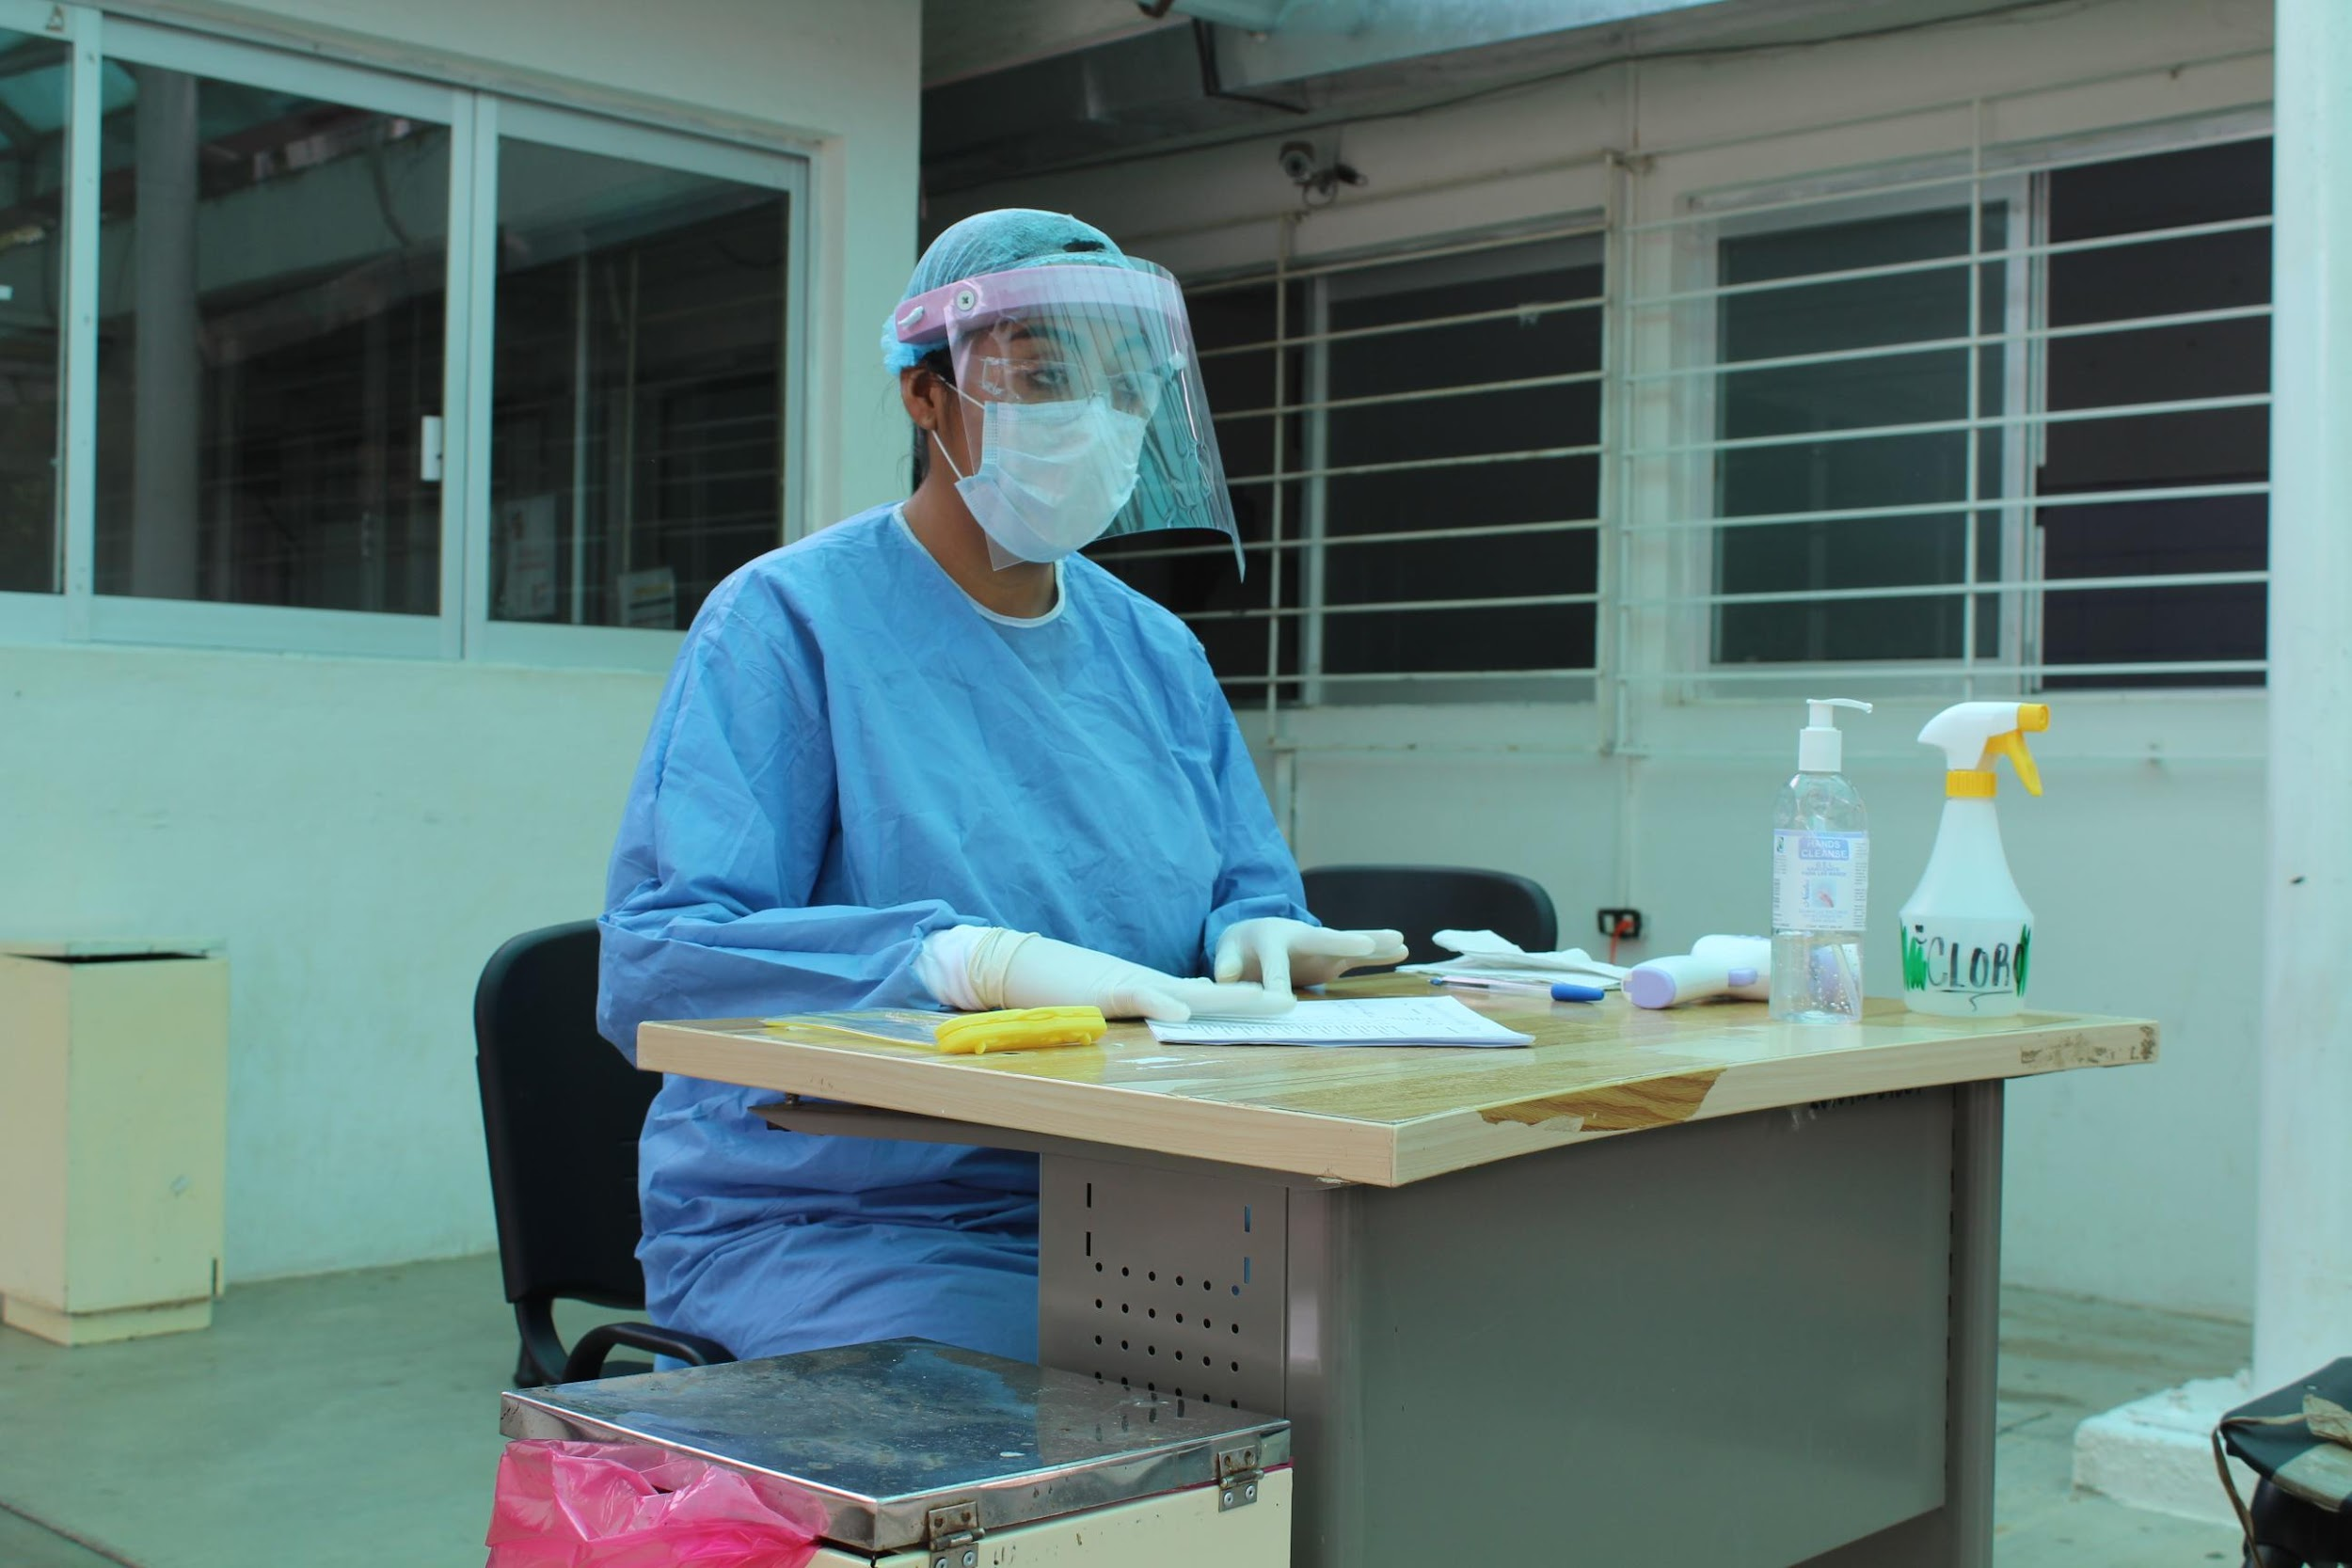
Conclusion
To our knowledge, our study is the first data-driven evaluation in Latin America of a CHW-led COVID-19 contact tracing intervention.
Our in-depth, data-based assessment of implementation challenges underscores the importance of early and ongoing evaluation of these programs to detect pitfalls that may be limiting the effectiveness of interventions, which is particularly relevant when resources are limited, as they can inform more optimal use of existing resources.

Slide 9
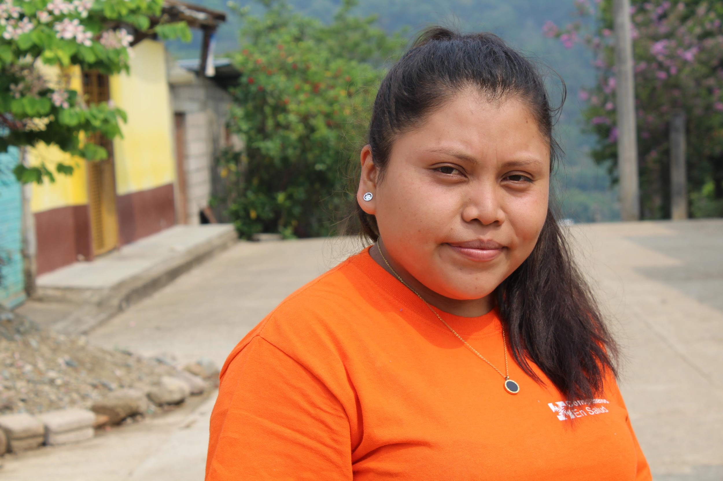
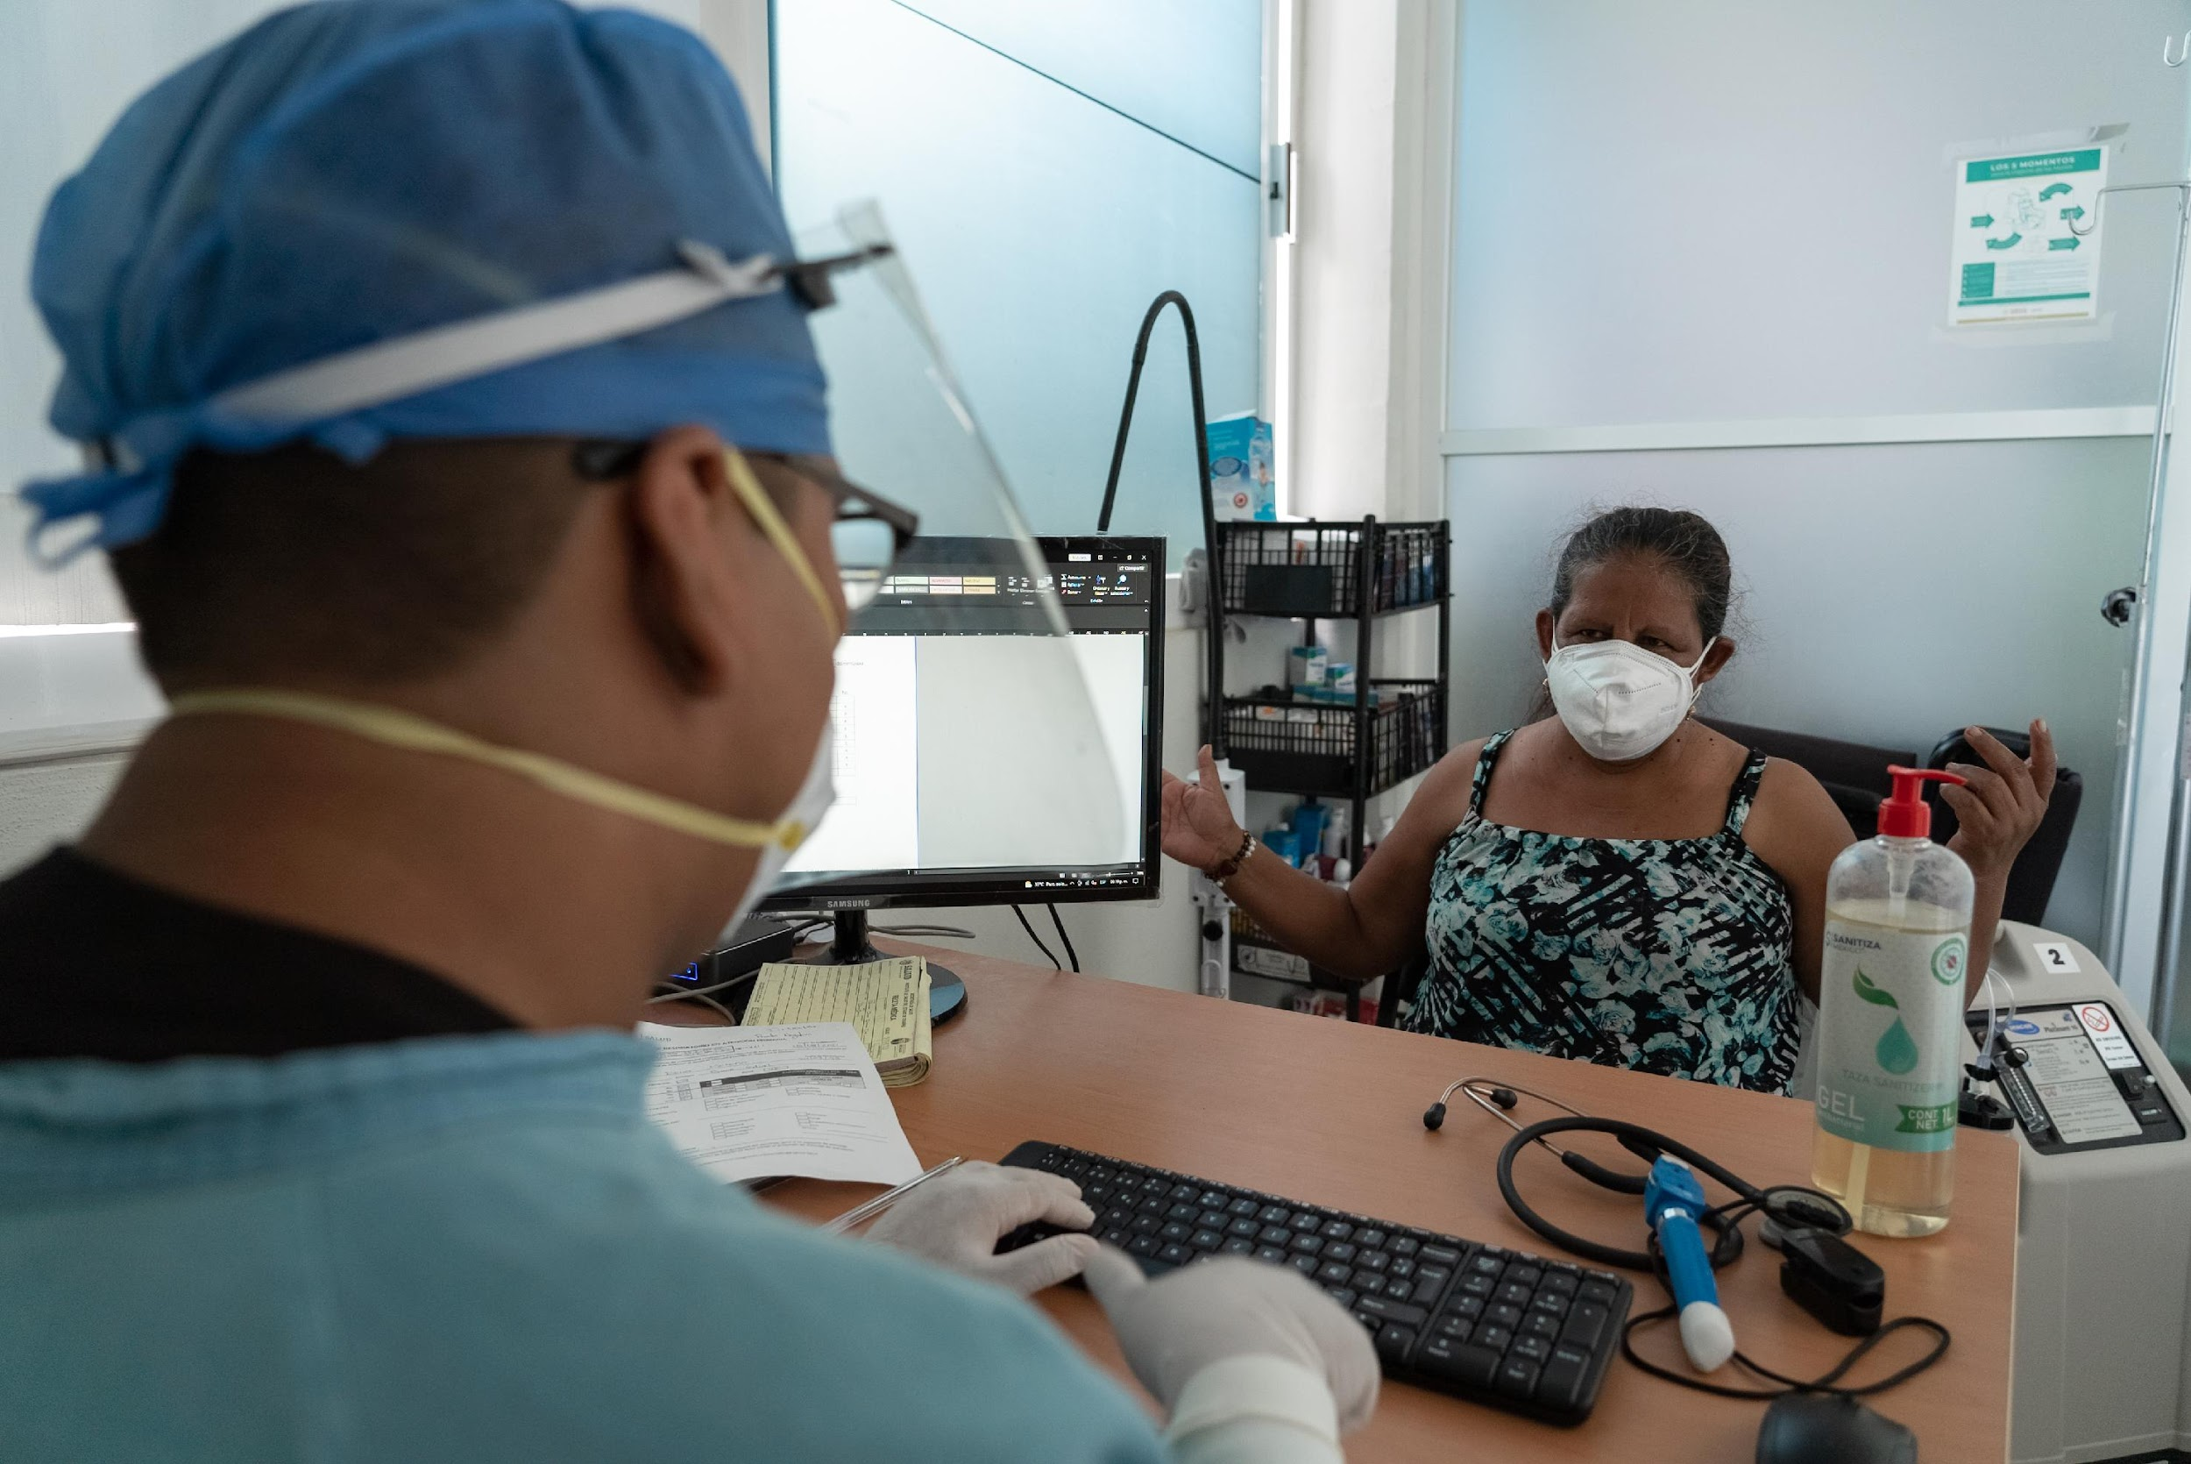
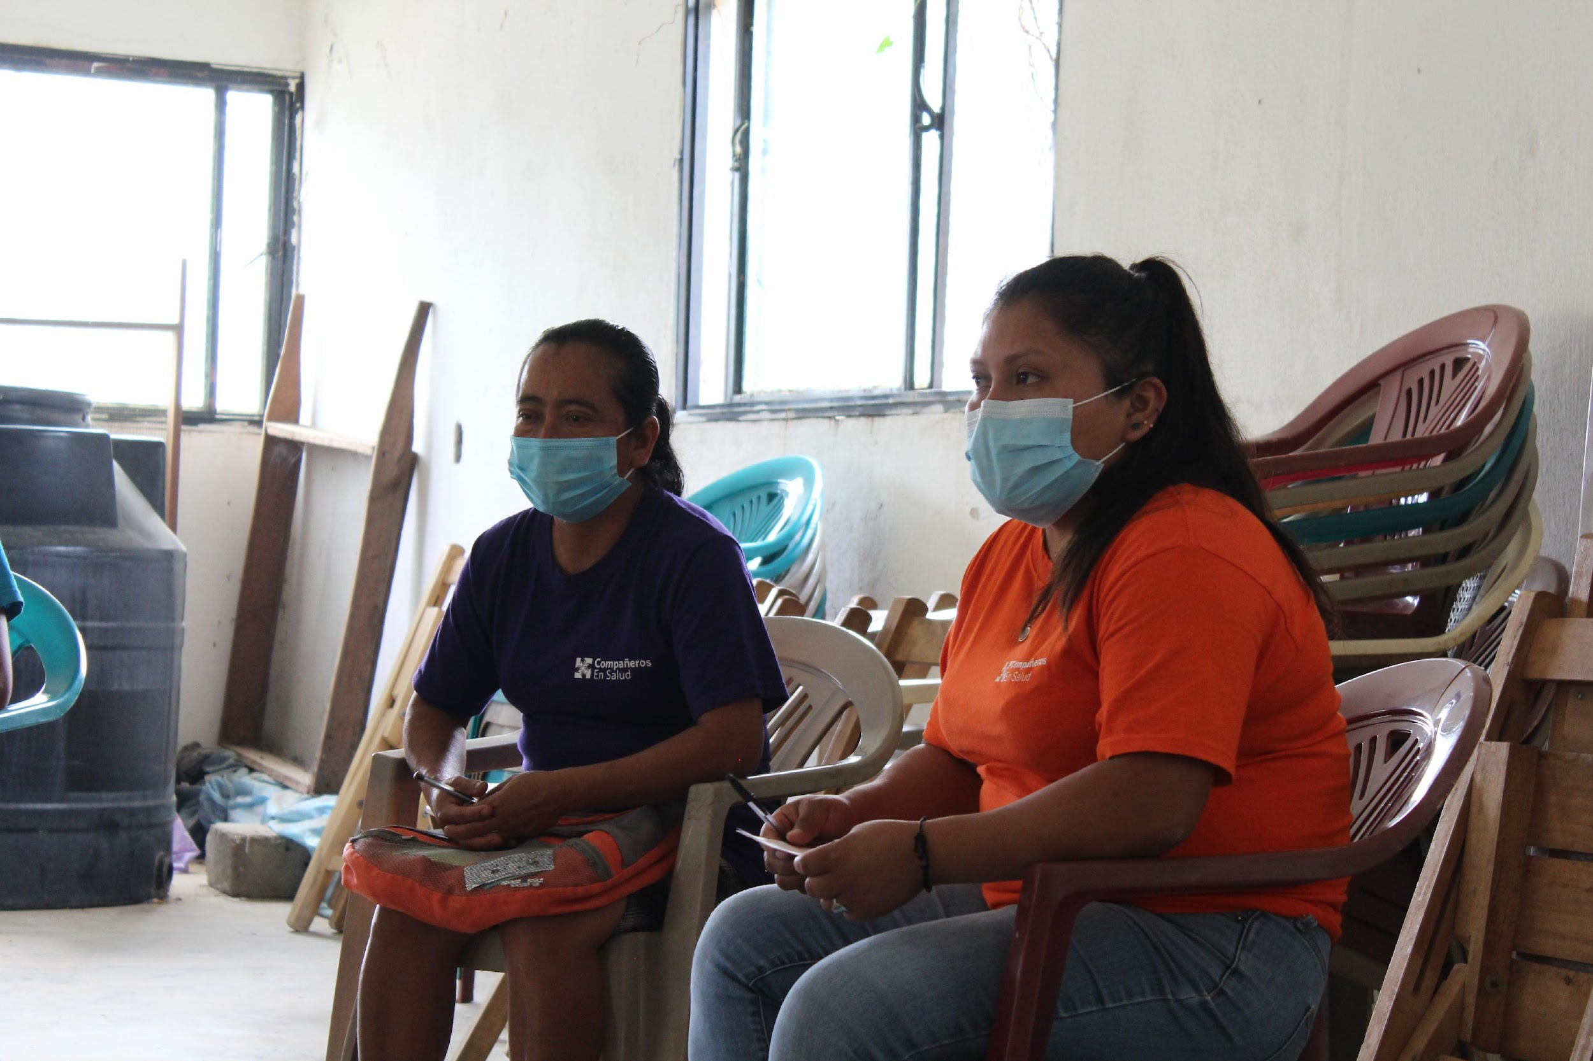
¡GRACIAS POR SU ATENCIÓN!
Zeus Aranda Remon
Coordinador de Investigación e Impacto, Compañeros En Salud
zaranda@pih.org
To submit Q&A questions, go to www.menti.com & enter code 5535 6338

